Slide 1


FINAL PRESENTATION
Presented by:
Karthik Ashok
Muhammed Althaf
Saravanan Balasubramaniam
Vinod Vijayaraghavan

Slide 2
TEAM ROLES
Karthik Ashok - Business consultant
Muhammed Althaf - Marketing consultant
Saravanan Balasubramanian - Technology consultant
Vinod Vijayaraghavan - Retail sales consultant

Slide 3

THE AGE OF PANDEMIC
The coronavirus has caused almost every Fortune 1000 company to experience an interruption of their routine business operations.
Across nearly every industry, multinational companies are confronting the stark reality that business will not go on as usual.
Further, economists have warned that the coronavirus outbreak could cost the global economy an estimated $1.1 trillion in lost income.
Some predict that the epidemic's after-effects will cause the global economy to shrink this quarter—for the first time since the end of 2008, when a shock to the financial sector caused turmoil for businesses around the world
Specifically, experts expect that technology companies, apparel makers and industrial-equipment manufacturers, as well as shipping companies, hospitality chains, airlines and the luxury goods sector will be among those hardest hits by the coronavirus.

Slide 4
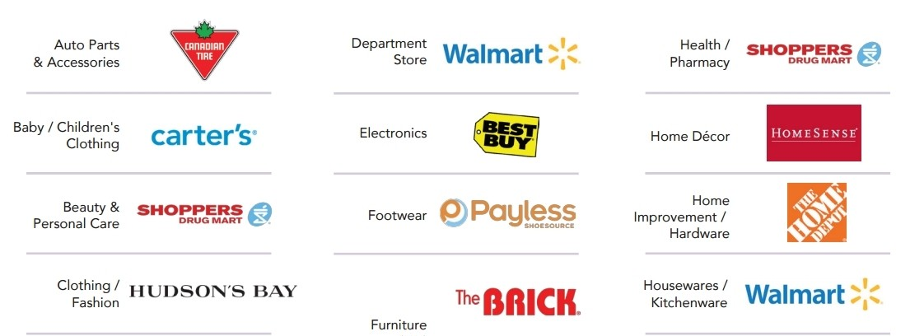
THE TOLL ON RETAILERS
As the pandemic has been unfolding, grocery retailers have seen massive sales and stockouts with customers pantry loading and panic buying in anticipation of an extended lockdown
In the short term, the product mix will be heavily focused not only on home consumption and health but also on entertainment, toys, home gym, and home improvement
This economic slowdown will impact the average basket size and mix of products as well as put pressure on prices and sales overall

Slide 5
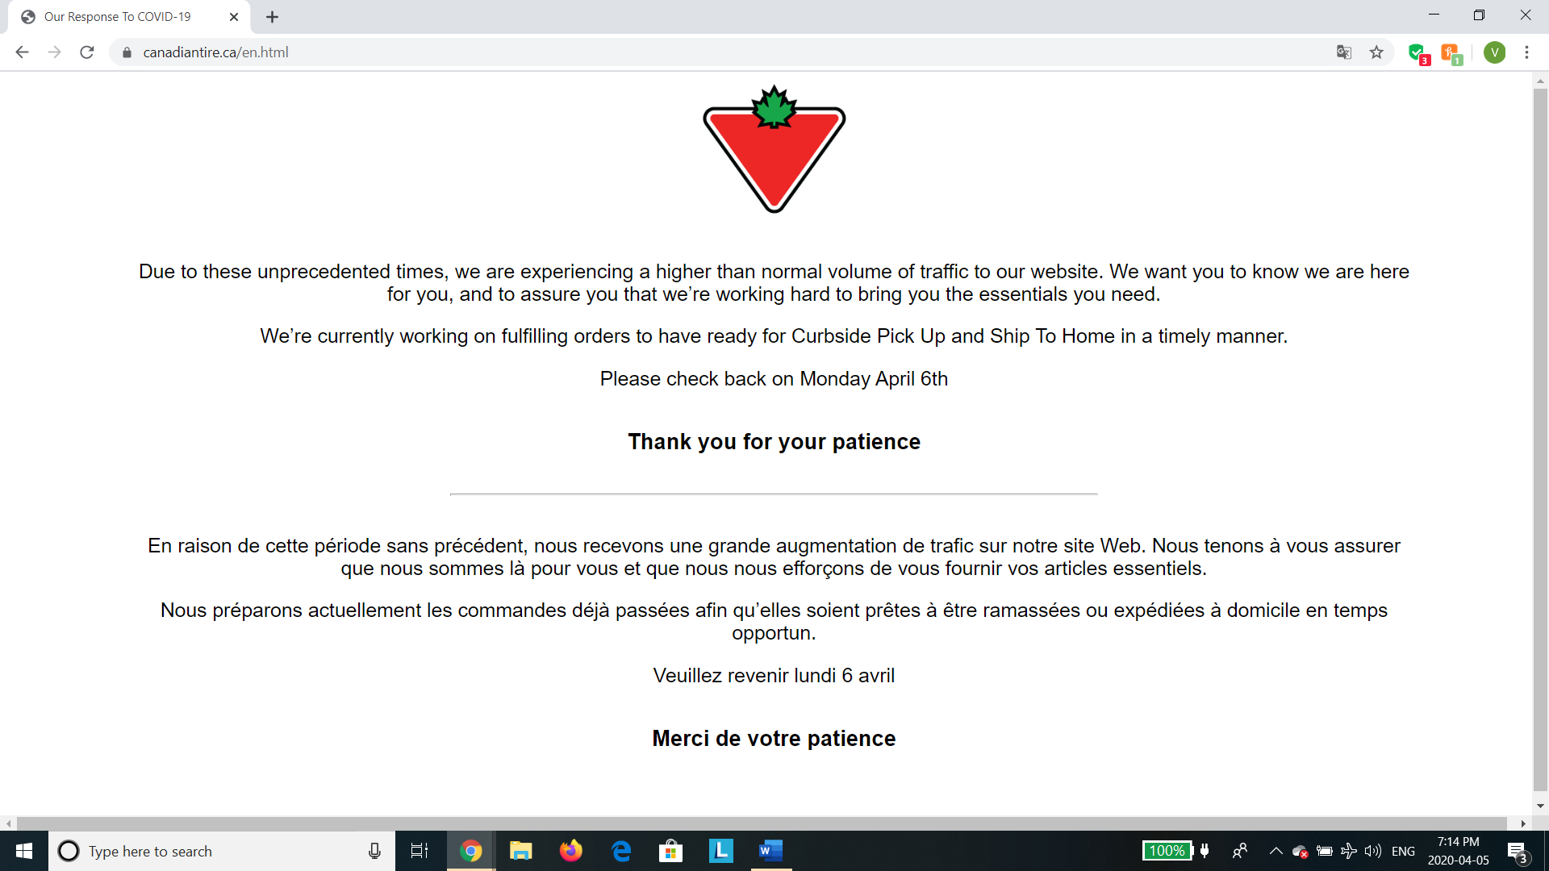
WHAT HAPPENED TO CANADA TIER?
Responding to the new COVID-19 measures announced by the Ontario government, Canadian Tire Corp. (CTC.TO) said it will limit its 203 Canadian Tire stores in the province to serving customers only through Curbside Pick Up or eCommerce home delivery.
However, the Canadian tier is struggling to cop up with the large influx of customers shopping online. Their Website was crashed due to this unexpected surge in online traffic.
Clearly this problem needs to be fixed and it needs to be fixed ASAP.

Slide 6

IS CLOUD COMPUTING THE ANSWER?
Any retail chain that wants to successfully sell products online as well as offline needs an ecommerce platform along with the service centers.
In the case of Canadian tier, they have a lot of service centers all across Canada, but their Ecommerce platform looks outdated, hence they are facing the problem of scalability during the time of Corona crisis.

Slide 7
BENEFITS OF CLOUD COMPUTING
Scalability
Stability
Speed
Savings

Slide 8
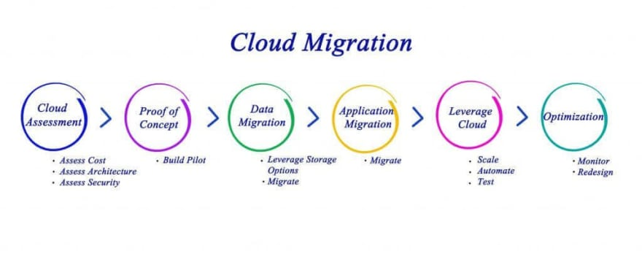
THE BIG THREE – CLOUD MIGRATION APPROACHES
There are three cloud migration strategies that companies should consider when taking advantage of the available cloud computing for their business
Depending on the nature of their business, some companies can settle on one migration plan that works across the board. For others, though, a hybrid cloud migration approach may be needed to achieve the best results for migrating data.

Slide 9

THE BIG THREE – CLOUD MIGRATION APPROACHES
The three approaches are:
Lift and Shift
Application refactoring
Re-platforming

Slide 10
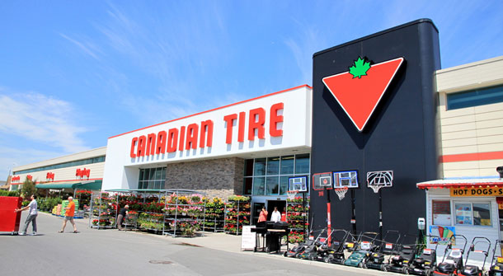
OTHER ASPECTS OF ONLINE RETAILING
Even though the notion of retailing online is not new, many retailers still do not operate an e-commerce website.
Online retailing is growing at an astonishing rate, with online sales now accounting for around one quarter of the total retail market.
Retailers who ignore e-commerce may see their trade lessening as customers continue to shift to ordering products online.
However, it is important to weigh all the advantages and disadvantages - backed by good market research - before deciding on whether or not to trade online.

Slide 11
PROS AND CONS OF ONLINE RETAILING
Advantages of online retail:
Easy access to market
Reduced overheads
Potential for rapid growth
Customer intelligence
Disadvantages of online retail:
Website costs
Security and fraud
Legal issues
Advertising costs

Slide 12

CAN ARTIFICIAL INTELLINCE MAKE A DIFFERENCE?
According to an IBM report, which surveyed 1900 retail and consumer product companies across 23 countries,
85 percent of the retail companies plan to implement intelligent automation for supply chain planning by the year 2021, and retailers believe that the introduction of AI will result in 10 percent annual growth.
Let’s see how AI will transform the retail industry.

Slide 13
ARTIFICIAL INTELLIGENCE THE FUTURE
These are some of the ways AI is changing the face of the retail industry
Better Customer Service
Better Data accumulation
Targeted Marketing Campaigns
Virtual Trial Rooms
MAP Monitoring

Slide 14

THE AFTERMATH
The long term social, economic and health impacts of the COVID-19 virus are still unknown.
Let’s hope that current global efforts to contain the virus and its impacts are successful.
And our view suggests that smart retailers are thinking about all of the scenarios and planning accordingly.

Slide 15
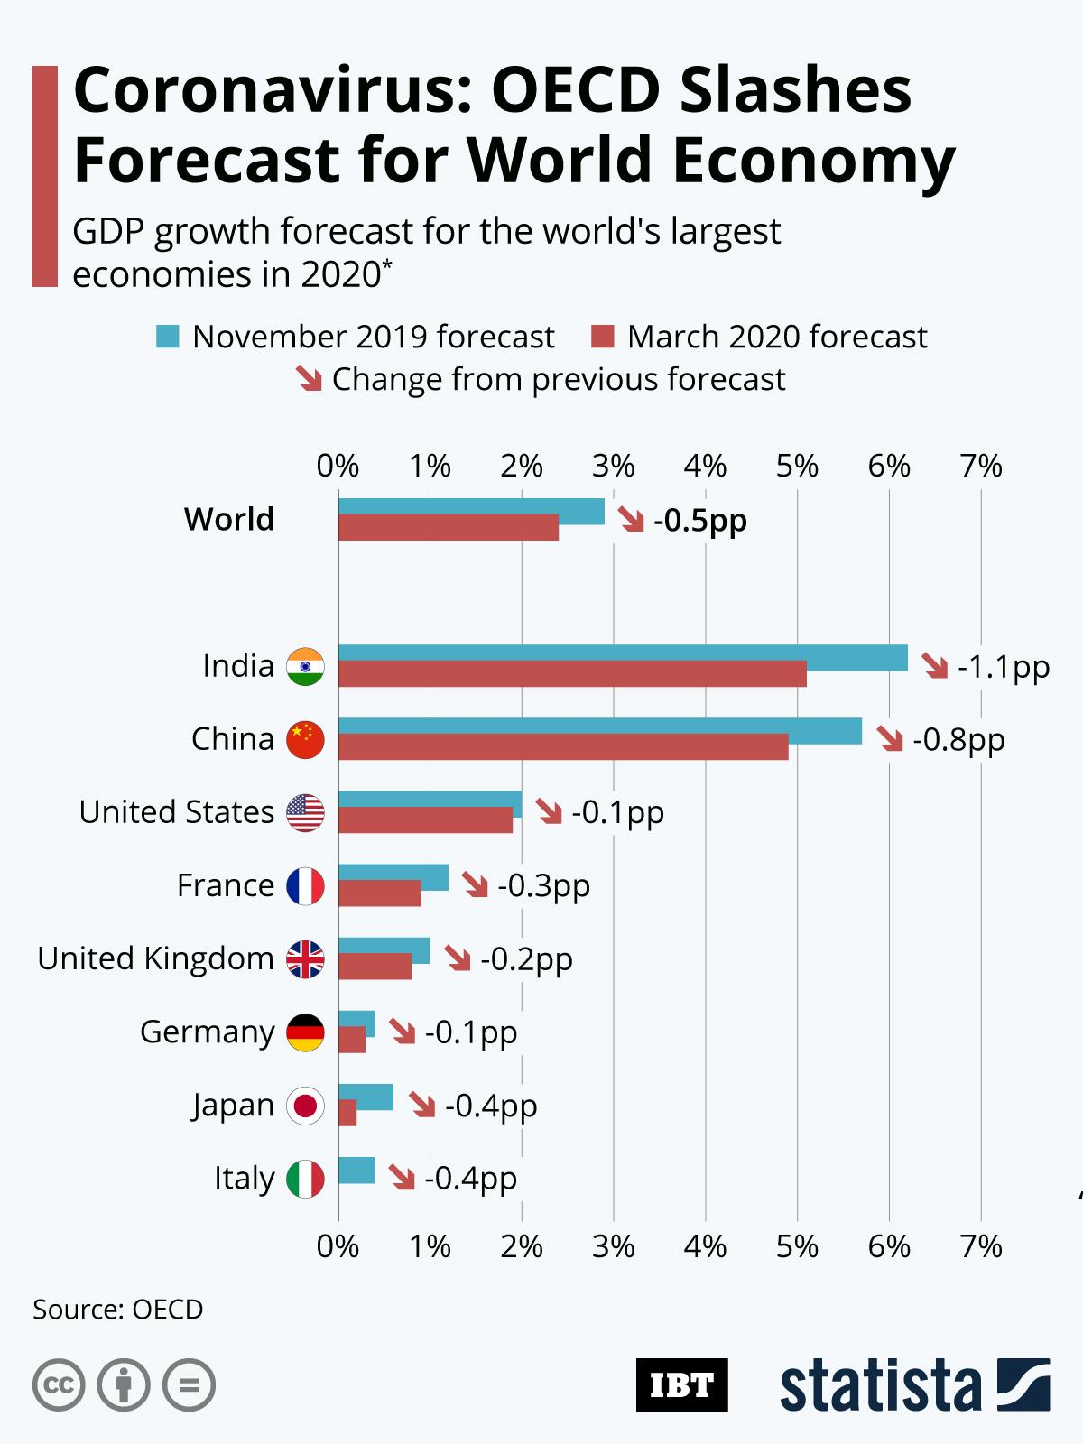
THE AFTERMATH
Over the coming weeks, our Consumer and Retail leaders from around the world will be sharing their views on these, and many other topics critical to the industry.
It will be our aim to bring together some of the best practices, innovative responses and new ideas that we see emerging across the industry as we deal with the implications of the COVID-19
Whether this situation lasts weeks or months, it is clear that the global response to this virus has fundamentally changed the reality for retailers. It's time to face that fact and start adapting.

